Slide 1
Short Tandem Repeats
Dale Annear^{1,} Geert Vandeweyer^{1,2,} Frank Kooy¹
Department of Medical Genetics, University of Antwerp¹ and University Hospital of Antwerp², Antwerp, Belgium

Slide 2
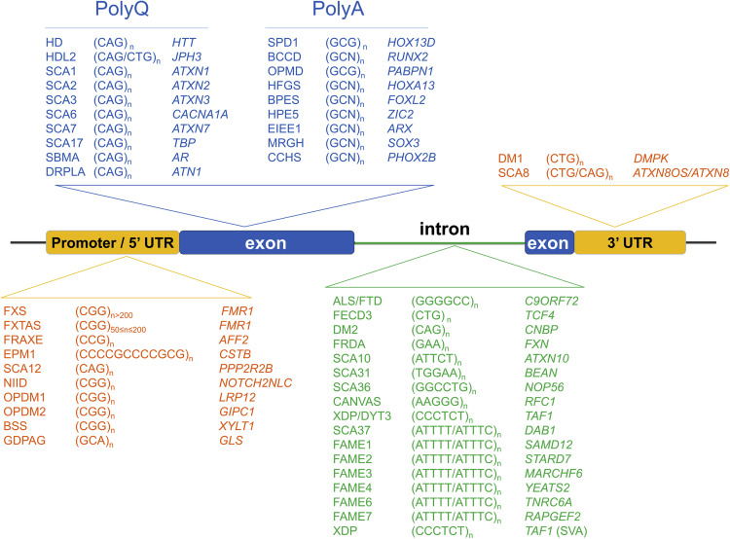
Short Tandem Repeats (STRs)
Short Tandem Repeat = STR = Repeat = Microsatellites
STRs ~8 % of the human genome
2 – 6 nucleotides/bases in length
Repeat in a head-to-tail fashion
Often variable in total length
When expanded can cause disease
Notes:
Change order

Slide 3
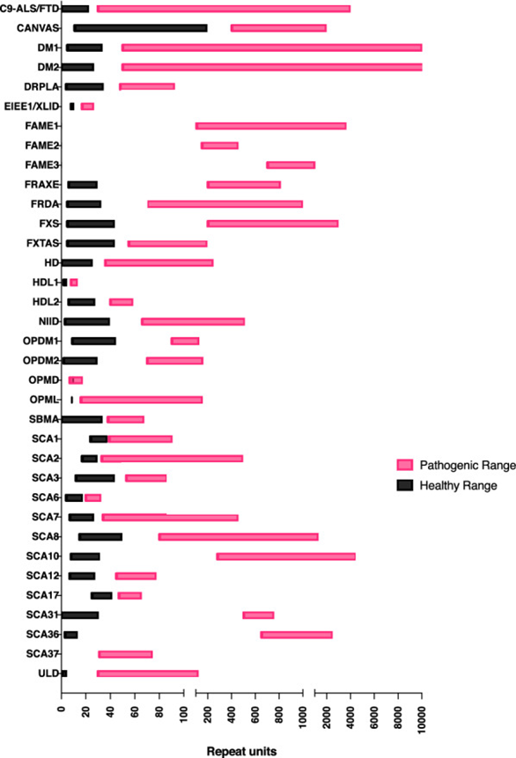
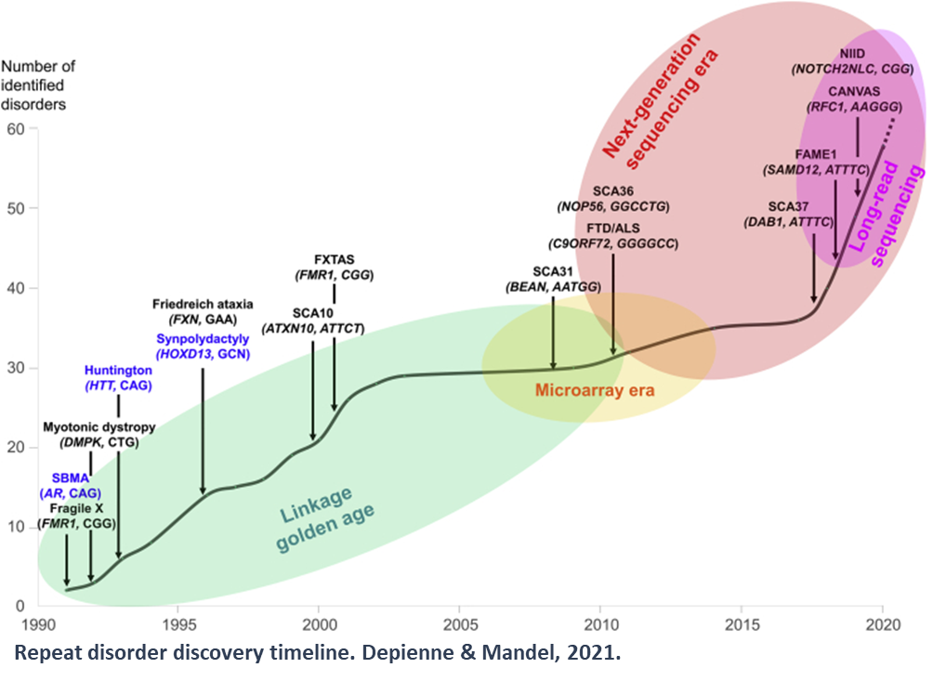
STR diseases
Notes:
Change order

Slide 4


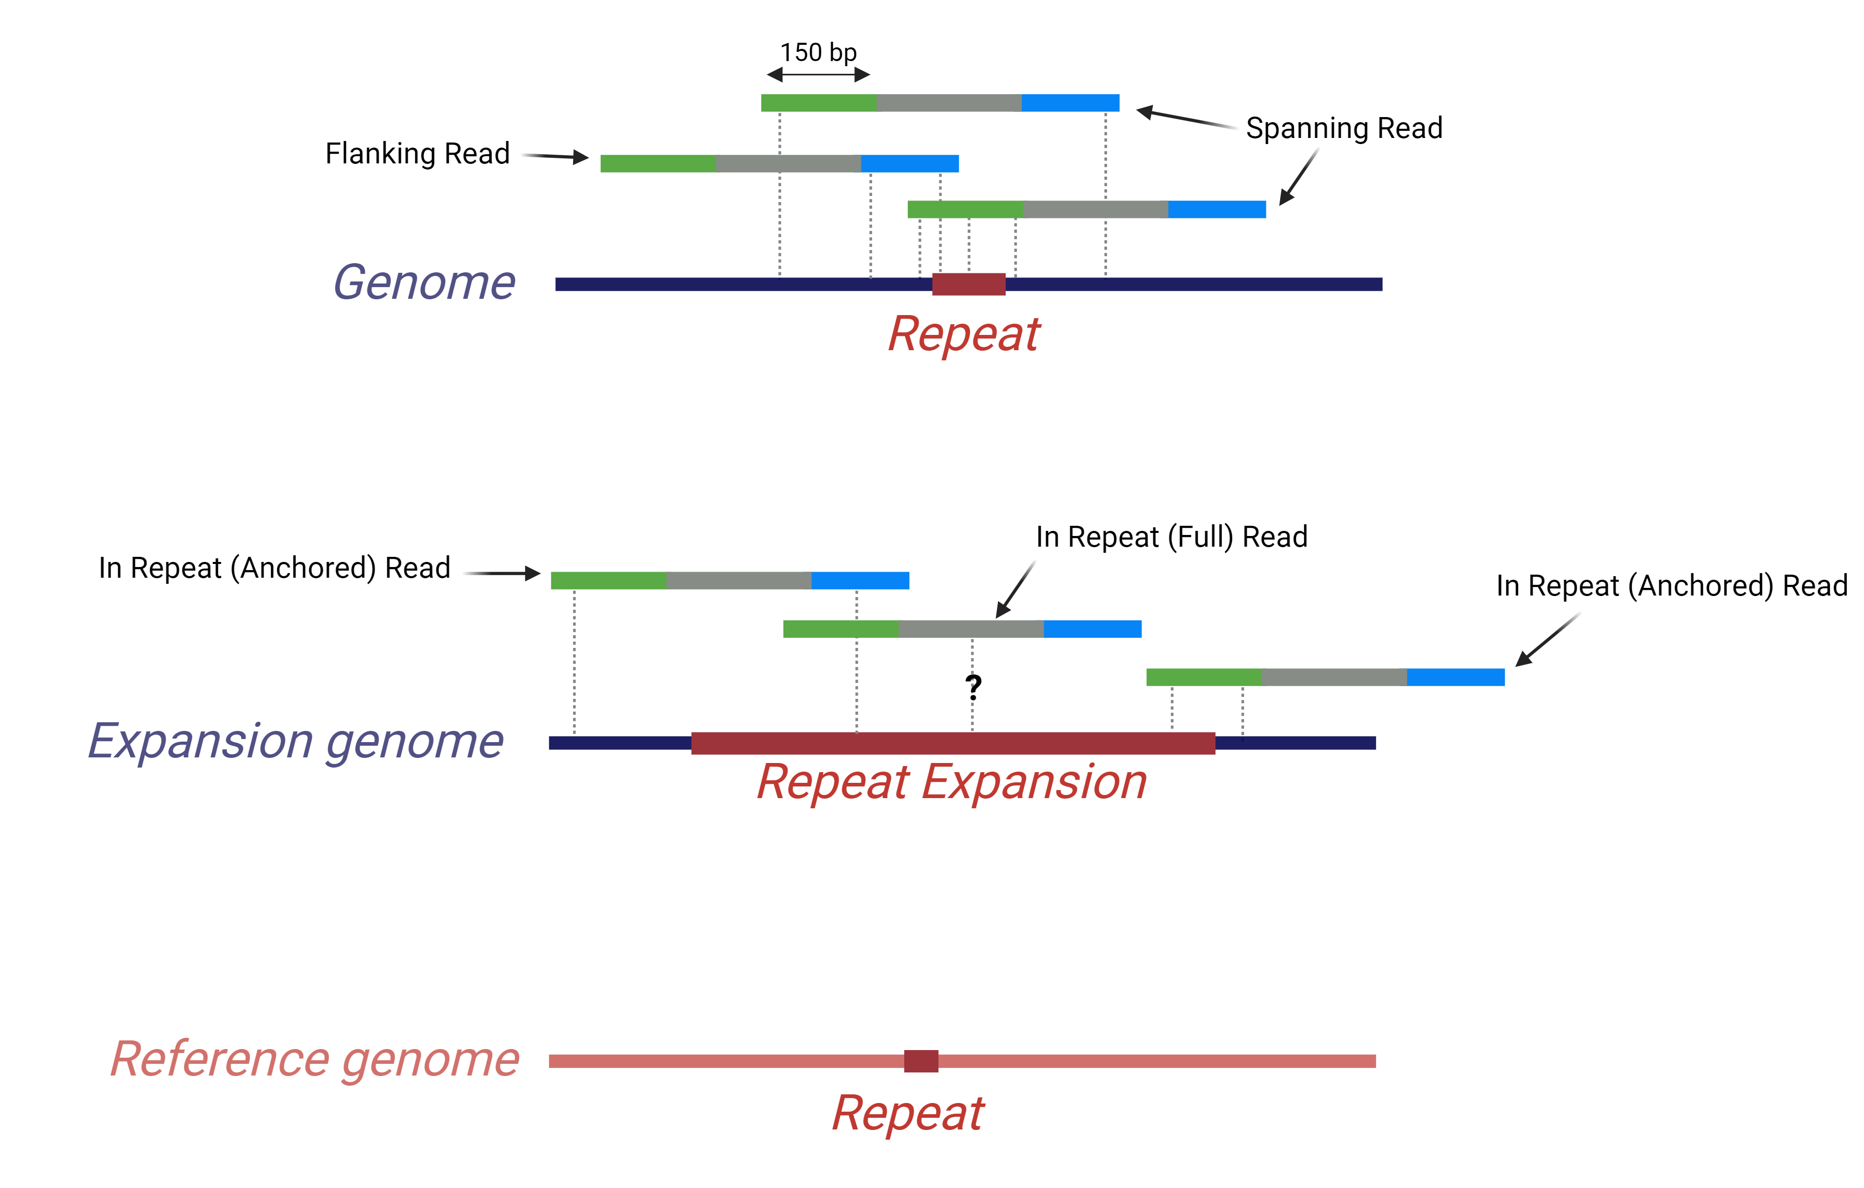
Limitations of Short Read
Notes:
Change order

Slide 5


The Genomic Landscape CGG Repeats
~ 6000 CGG-STR loci
Genomically ubiquitous, gene-enriched
Enrichment of CGG-STRs in genes linked to neurological function
100s mirror the disease-associated repeats
Notes:
Cite paper for details

Slide 6
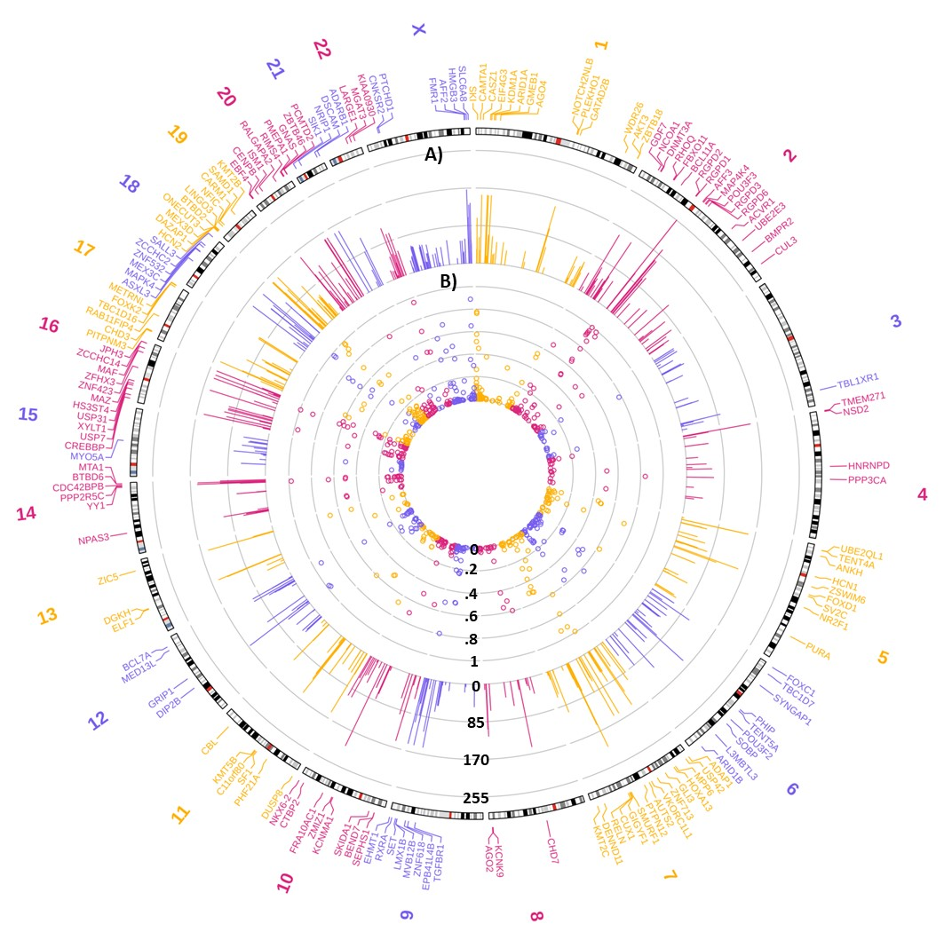
Notes:
Not many pathways. Remove. CGG Repeat implicated in x, y, z. MetaScape ->Checkfor pathways

Slide 7
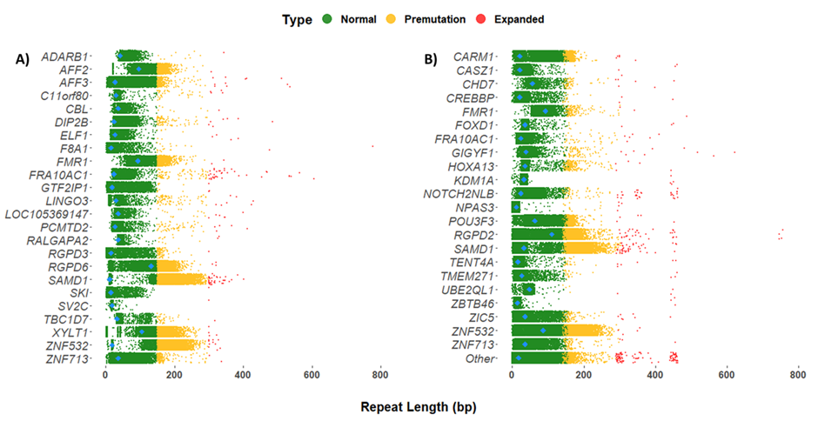


CGG Repeat detections by gene
Large Expansion = > 300 bp = > 100 CGG Units
All CGG repeat lengths observed in the genes that displayed large repeat expansions
Notes:
Patient cohorts (12,146 Individuals)
419 large gene-localised expansions
118 unique genes
Over representation of expansions in the gene 5’-UTRs

Slide 8
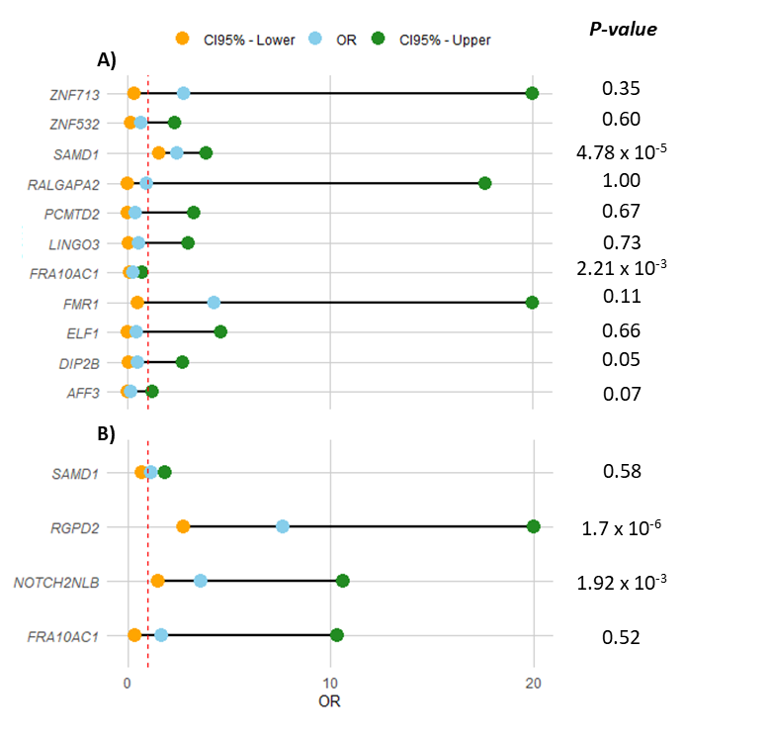
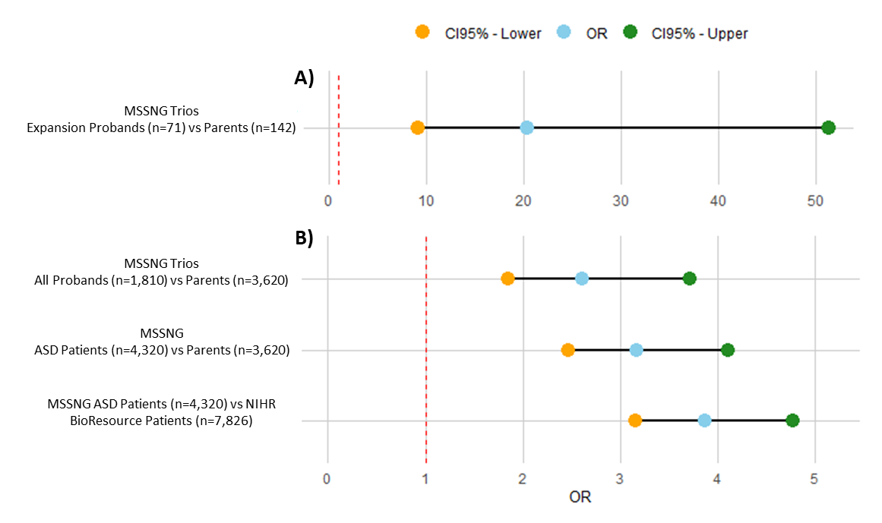
ORs CGG Repeat Expansions
Notes:
Change order

Slide 9
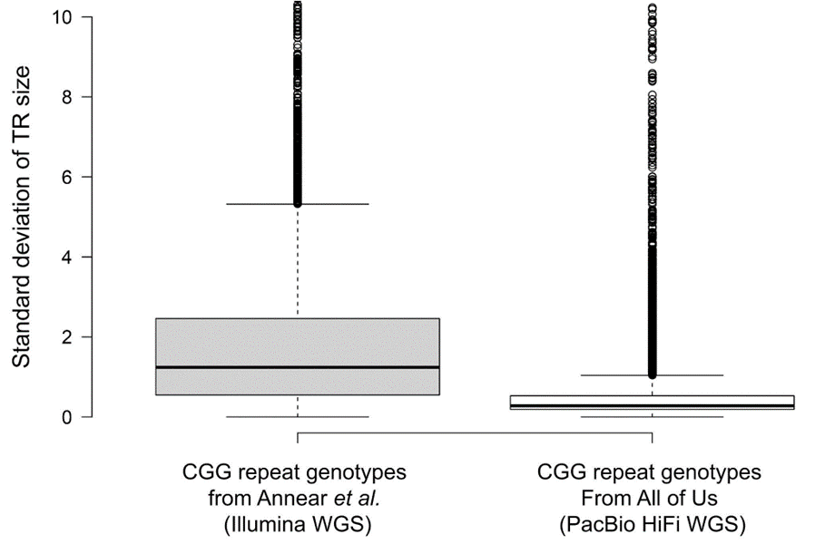
Repeat Variation (Short Read Vs Long Read)
Notes:
Change order

Slide 10


Why long read?
Longer Reads
Structural Variation Detection
Phasing of Haplotypes
Epigenetic Modifications
Reduced Need for PCR Amplification
Improved Accuracy De Novo / Alignment Assembly
Notes:
Change orderWhy move to log read if you’re only going to explore a set panel of genes
Where do the benefits of long read sequencing really lie?
What is the benefit of moving onto long-read sequencing

Slide 11
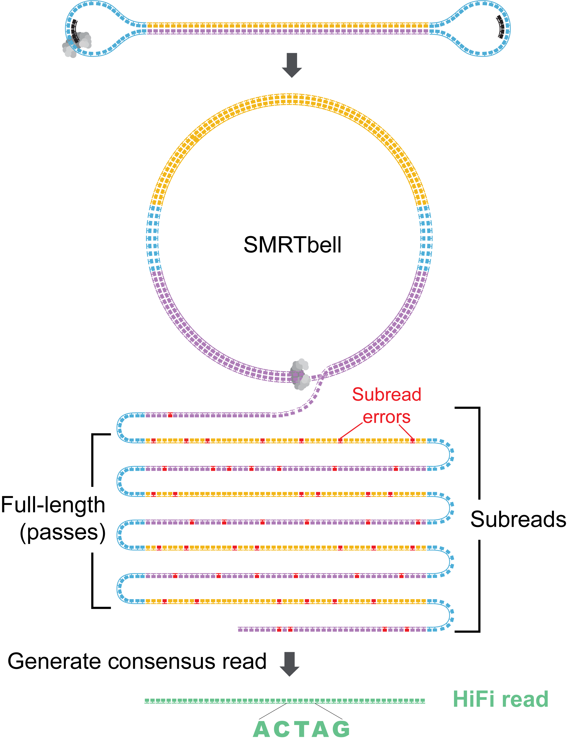
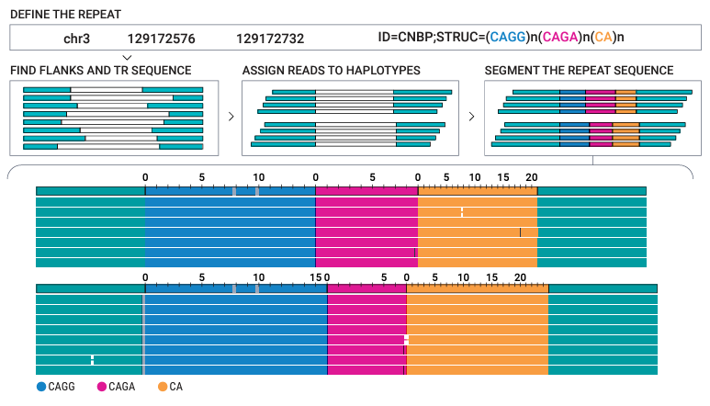
PacBio HiFi Sequencing
Long-read HiFi sequencing data
”Preferred”* method of STR analysis
In-house development of STR analysis platform
The Tandem Repeat Genotyping Tool (TRGT)
Notes:
Change order

Slide 12

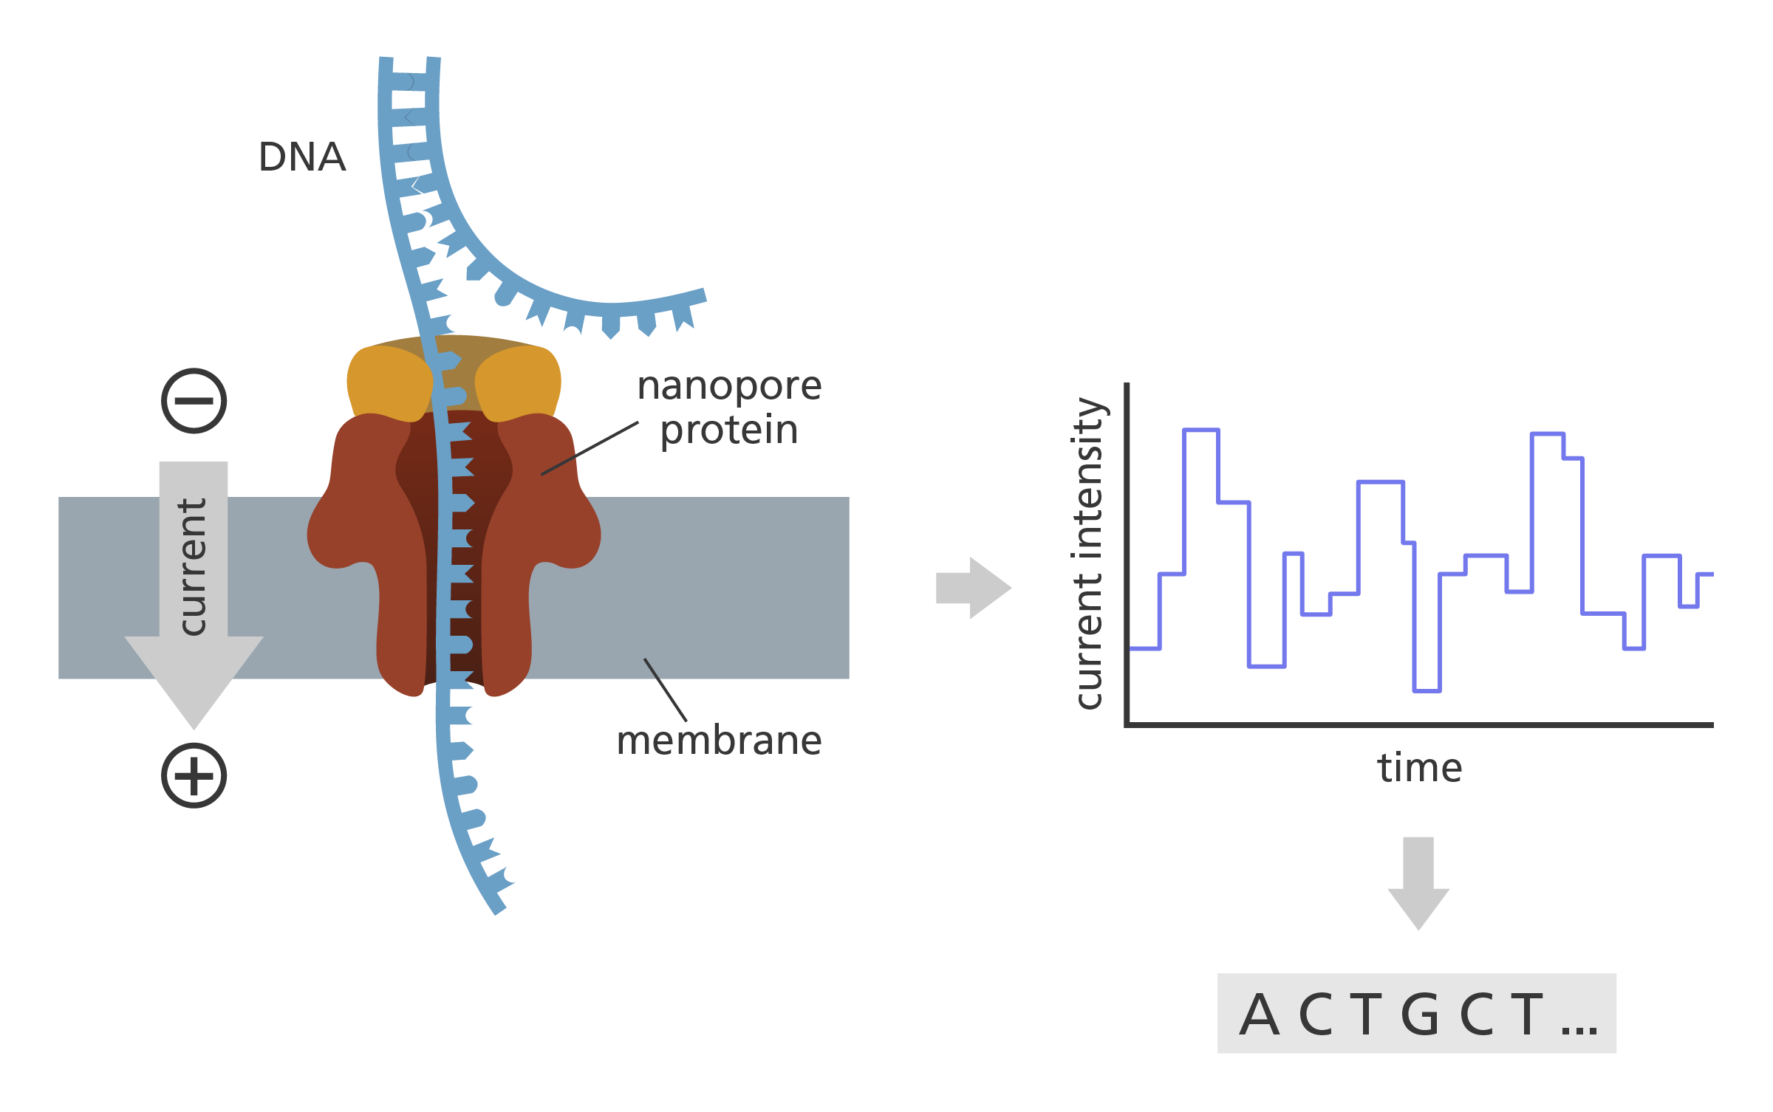
ONT Sequencing
Developments in basecalling and duplex sequencing has greatly increased performance in regard to STR sequencing
Adaptive sequencing
Affordable
Notes:
Change order

Slide 13
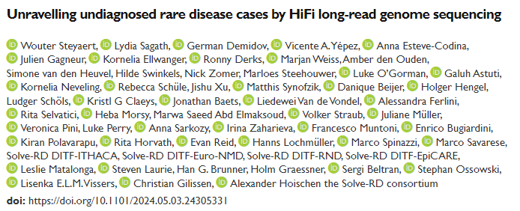
Discovery of Repeat Diseases
Repeat expansions in RFC1 causing CANVAS-spectrum disorder
Homozygous repeat expansions of the AAGGG motif in the RFC1 in ataxia
Family with autosomal dominant ataxia, repeat expansion in DAB1, known causal gene for Spinocerebellar ataxia 37 (SCA37)
Notes:
Change order

Slide 14
STR Tools for Long Read Data
Tool | Author | Journal | GitHub | Platform
LongTR | Jam et al 2024 | bioRxiv | github.com/gymrek-lab/longtr | PacBio / ONT
Straglr | Chiu et al 2021 | Genome Biology | github.com/bcgsc/straglr | PacBio / ONT
TRGT | Dolzhenko et al 2024 | Nature Biotechnology | github.com/PacificBiosciences/trgt | PacBio
ExpansionHunter* | Dolzhenko et al 2019 / Oketch et al 2024 | Bioinformatics / PLOS ONE | github.com/Illumina/ExpansionHunter | PacBio / ONT
STRdust | De Coster et al 2024 | Genome Research | github.com/collaborativebioinformatics/STRdust | PacBio / ONT
RepeatHMM | Zhang et al 2017 | Genome Medicine | github.com/WGLab/RepeatHMM | PacBio / ONT
Notes:
Change order

Slide 15

Take Home
Short Tandem Repeats are causative of many diseases
Long read sequencing opens options
Pay attention, things are moving fast
Notes:
Change order

Slide 16

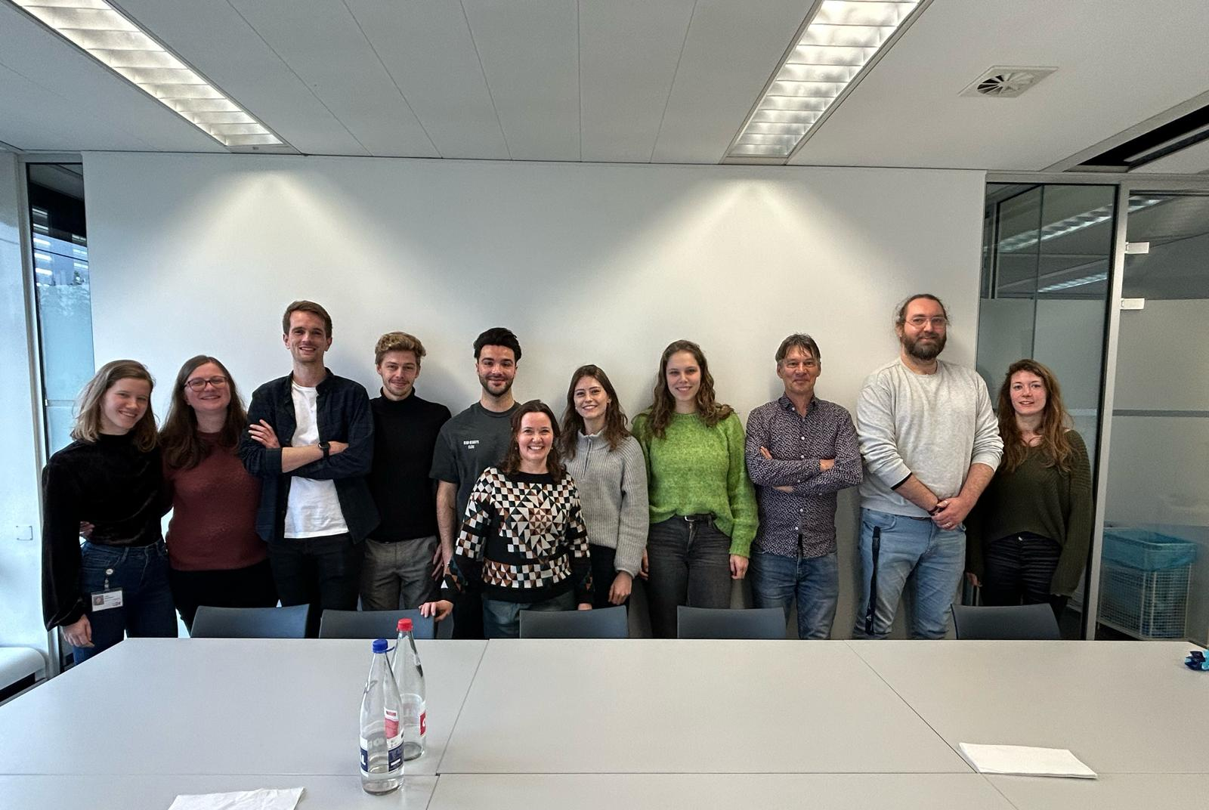




Cognitive Genetics
Frank Kooy
Geert Vandeweyer
Anke van Dijck
Dale Annear
Ellen Elinck
Jolien Huyghebaert
Claudio D’Incal
Kirsten van Rossem
Mathijs van der Lei
Luna Deconinck
Kevin de Man
Lusine Harutyunyan
16

